Slide 1
CAR INSURANCE COLD CALLS
Predicting the important factors which determine cold call success

Slide 2
ABOUT THE DATSET
Data From Client: STAR BANK UNITED STATES
Bank concentrates on Car Insurance and organizes regular campaigns to attract new clients
The bank has potential customers data, and bank’s employees call them for advertising available car insurance options. We are provided with general information about clients (age, job, etc.) as well as more specific information about the current insurance sell campaign (communication, last contact day) and previous campaigns(attributes like previous attempts, outcome).
Located in United States they operate in almost all states and they try to convert already existing insurance customers from a different agency to STAR by their marketing campaigns mostly Cold Call

Slide 3
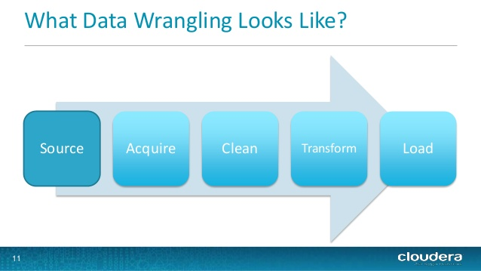
DATA WRANGLING / DATA MUNGING
Data Wrangling or Data Munging is the process of converting data from one form to another to better understand it.
Here in our case our data is available to us as a CSV file and lets use our powerful python data science libraries to load it into a dataframe.

Slide 4
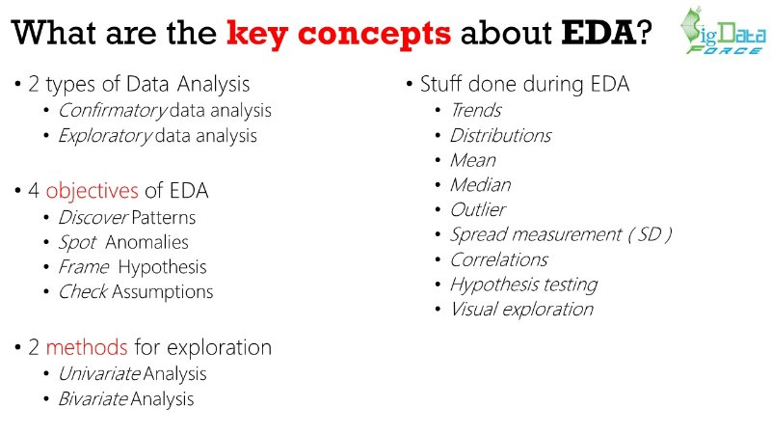
EXPLORATORY DATA ANALYSIS
Exploring is always fun and the new insights you can find is always interesting.
Starting from the shape of the dataset to knowing about the columns, datatypes and the statistics part of it gives us a lot more of understanding and deep dive into the data.
By having a look at the Balance amount in our dataset 75% of the field is 1619 and the max is 98417. Nice, we are exploring !!

Slide 5
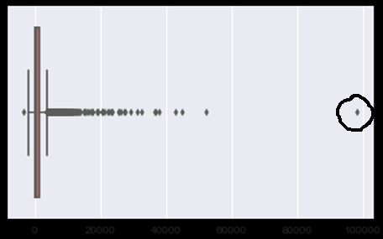
OUTLIER ANALYSIS
An Outlier is usually an observation which typically lies farthest from the mean.
According to Statistical theory if any observation is 3*IQR(Inter Quartile Range) from the mean then its called an Outlier.
Sometimes values are distributed randomly such as a Balance amount - from our boxplot below looks like more values have crossed the whisker.
One particular data point is too far when compared to the other points in the data and the outlier is dropped from the dataset.

Slide 6
HANDLING MISSING VALUES
Missing values are a major concern with data analysis and dealing them is another hurdle. Python treats missing data as NaN but does not include it into calculations and visualizations. Also predictive models cannot be built without treating missing values. In our case missing values occurs mostly in Outcome and Communication fields. Job and Education have considerable amount of missing values.
IMPUTING MISSING VALUES
The missing values like Job and Education are very few and can be imputed using backfill/front-fill pad method in python .Outcome and Communication have quite a lot missing values and hence they are imputed using None in place of NaN values.

Slide 7
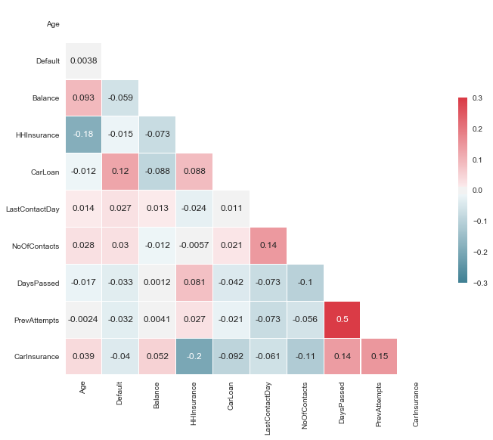
CORRELATION
Correlation is used to determine the relationship between two variables/ fields. Correlation varies from -1 to 1; if the Correlation is 1 then the fields are positively correlated, 0 having no correlation and -1 is negatively correlated. Lets see how each attribute correlates with one another using Heatmap. Looks like there is not much of a correlation among variables but DaysPassed and PrevAttempts have a positive Correlation with each other.

Slide 8
DATA VISUALIZATION
Key takeaways from the Pair plot
Visualization is an important aspect of Data Science without which its pretty difficult to arrive at an outcome easily. Even though the result is determined in tables there is a pain point in looking at each values and coming to a conclusion. Charts/Graphs are much helpful to accomplish those tasks with ease even to a non-technical person. Executives and managers love to look at a report with visualization so that they can easily come up with complex decisions. Below is a pair plot which pairs fields of interest and plots them. The variables for the Pair plot are selected from the heatmap which have an impact on the outcome
Older people are more likely to Buy Car Insurance.
People having prior Car Insurance and Home Insurance are less likely to purchase.
People give a positive sign if the days passed (time before they were contacted) increases.
When you contact persons frequently their buying tendency increases after 20+ contacts.
No.of contacts and PrevAttempts work the same , more the better i.e increases Car Insurance purchase.

Slide 9
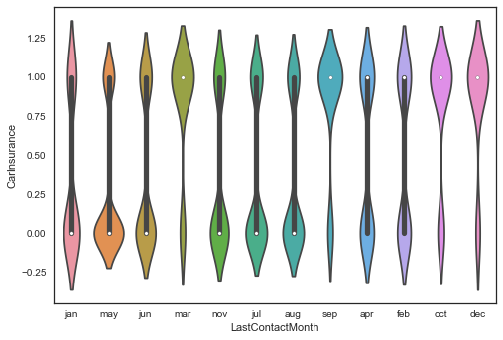
LOOKS INTERESTING
Violin plot has bulges near value 1 in y axis shows that Mar, Sep, Oct and Dec are the desired months for people buying Car Insurance. The Count plot below has more missing previous campaign outcome where majority said “No” to car insurance.

Slide 10
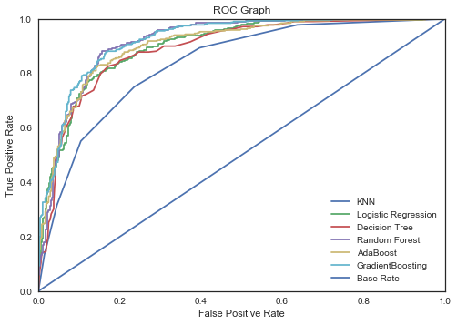
ROC CURVES
Another important visual model validation technique is the Receiver Operating Characteristic(ROC) Curves, which plots the true positive rate and the false positive rates. The curve is a good validator of the models and helps us determine whether our model works best. When the AOC( Area Under Curve) is maximum and when its towards the upper left then the model works best. The ROC has all the models plotted and Gradient Boosting(XGBoost) and Random Forest towards the upper left showing that those predictor models are the best.

Slide 11
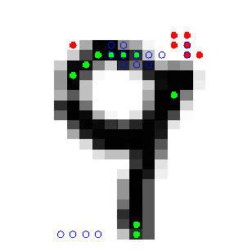
FEATURE ENGINEERING/ FEATURE EXTRACTION
Feature Engineering is an essential element to a Machine Learning Problem. Picking a feature from a set of attribute determines how well the algorithm will work in making predictions, so this part is a crucial one. In our problem there are a list of continuous variables like Age and Balance and they need to be binned. The Age and Balance continuous variables are bucketed using quartile cut function into 5 segments.
There seems to be a unique problem with respect to the CallStart and CallEnd attributes and are recorded as object variables which can be computed easily using the datetime function, so converting it to datetime function and subtracting them arrives at the actual CallTime which can be further binned as above.
Categorical variables can also participate in model building provided that they get their dummy values in order to be included. Well, we would have more columns included to our dataframe by this procedure.

Slide 12
PREDICTIVE MODEL BUILDING AND VALIDATION
Predictive Models are built to correctly classify the unknown label inputs, the models are trained using the labeled outputs so that it can learn from them and correctly classify the non labeled items. There are a lot of Classification Predictor Algorithms incorporated into Sklearn and in our case we have utilized most of the classification algorithms related to our problem. Our Classifiers include
kNN
Logistic Regression
SVM
Decision Tree
Random Forest
AdaBoost
XGBoost

Slide 13
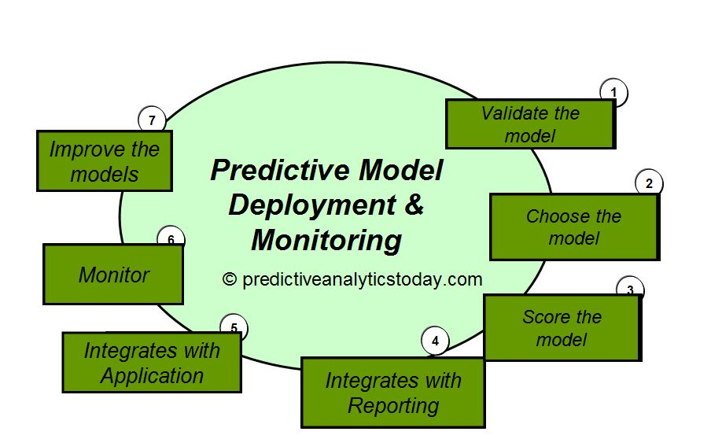
MODEL VALIDATION
Validating our models built is a key component which helps in determining the model's predictive power. Starting from the most common accuracy score, cross validation score to classification report(precision, recall, f1-score,support), ROC curves and Confusion matrix , the models have gone through extensive validation to choose the best predictor.
BEST MODEL
The best model is a tie between Random Forest and XGBoost both doing their part well with good accuracy scores, less false positives and true negatives.

Slide 14
FEATURE IMPORTANCES
Knowing which feature has a major part in determining the output can be very useful and help in working on them to increase the output of the solution. Finding the important features can be very handy when making important decisions and conclusions. The Important feature identification is done by using models such as Logistic Regression and Decision trees. Both of them provide very good clarity in identifying the features. The Graph below shows the most important features determined by the ExtraTreesClassifier and the top 10 features are
CallTime
LastContactDay
Balance
NoofContacts
Outcome_success
Age
HHInsurance
Communication_none
Dayspassed
Outcome_none
Features determining Cold Call Success

Slide 15
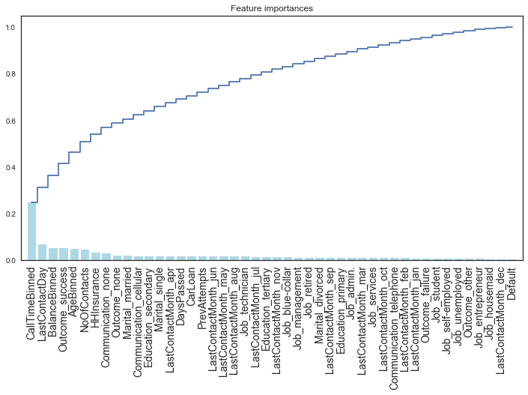

Slide 16
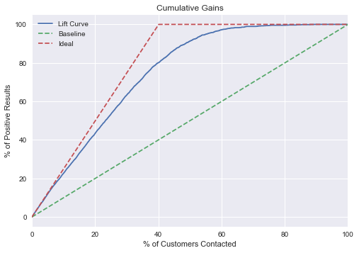
CUMULATIVE LIFT AND GAIN CHARTS
Cumulative Gain chart is used to determine how well the model does the Classification task in identifying the positives,(i.e) Cold Call Success. The chart is drawn between the Cumulative % of the Population(the people contacted in our case) to the Positive responses(Cold Call Success). It is one of the very useful validator in business and can help in determining the accuracy of our model classification results.
So, for the first decile which has 10% of the customers contacted,20% of positive results has been obtained giving us a Lift of 2 which means that we get twice the positive results by using a predictive model rather than just using no model. Let's say for every cold call success the company generates a revenue of $100, by using the predictive model we designed its possible to double the revenue. Isn't it a great advantage?

Slide 17
CONNECTING THE DOTS
The major problem we tried to address is cold call success and below are some key result interpretations. Cold Call Success is tied with the CallTime, when the representative engages with the customer and creates a rapport with them then most people say yes to the CarInsurance. LastContactDay also plays a crucial part in determining the Cold Call Success (i.e) following up with a customer after a Cold Call. Their account balance can be more of a sign since people having more balance have opted for the CarInsurance.
NoofContacts -how many times the person has been contacted also determines the cold call success. More times the better, which closely related to following up on a continuous basis. Previous campaign outcome success is also a major factor. Older People have more tendency to buy Car Insurance than younger people so that major importance can be given to the older age groups. The Best Model predicts whether the Cold Call will be a Success or not and hence by working on the above mentioned points and trying to improve the important features like CallTime and following up can improve the results to a farer extent.

Slide 18
POSSIBLE SOLUTIONS
Train the employees working in the Call Center with people skills so that during call they can be more friendly and engaging
Maintain a tracker which reminds of follow-ups so that the representative can talk to the person again and try to convince them in purchasing Car Insurance
Select people having good credit score and account balance so that the time invested in them is useful
Concentrate on Older People with age above 40 because compromising them for a new plan is easy as per the previous data
Contact persons from the previous campaign who responded since they are more likely to buy Insurance

Slide 19
THANK YOU

